Slide 1
CARE OF DYING PATIENT
Prof. Quazi Tarikul Islam
Professor of Medicine
Popular Medical College Hospital

Slide 2
Who are in end of life :
Patients who are about to pass away.
The last stage of life, a process that form a medical point of view begins when a person has a disorder that is untreatable and inevitably ends in death.

Slide 3
Palliative Care and Hospice Definition of Terms
Palliative Care: biopsychosocial and spiritual care of persons whose diseases are not responsive to curative treatment
Goal of Palliative Care: to produce the best possible quality of life for the patient and family
Hospice: Medicare sponsored program dedicated to provide palliative care for terminally ill patients and their families

Slide 4
Palliative Care
Whole person care for patients whose diseases are not responsive to curative treatment.
Usually provided by an interdisciplinary team:
Nurses,
Certified Nurse Assistants, or home health aides
Social workers
Physicians
Spiritual Care Providers,
Other health care professionals

Slide 5
History of Palliative Care
Beginning of Time: caring for each other
Middle Ages: Convents, Hostels, Hospitality Inns
Early years of Medicine: symptom management, comfort, sitting bedside
Modern Era: Treatment and Cure over comfort
Modern Hospice Movement 1970’s
Dame Cicely Saunders

Slide 6
Benefits of Palliative Care
Honors residents’ wishes for dignity
Provides evidence based measures for good symptom management
Demonstrates partnering and collaboration with:
resident, family, staff, and palliative care team
Provides a common platform to discuss
Goals of Care
Advanced Directives

Slide 7
Palliative Treatments
All types of therapeutic measures, including very aggressive therapies, that are utilized to control pain and other distressing symptoms.
These therapies will not change the course of the condition, the intention is to relieve the pain or symptom

Slide 8
Overall Goals of Palliative Care
To eliminate or reduce discomfort
To improve quality of life
To improve mood
To decrease fatigue
To decrease pain

Slide 9
When to discuss palliative care :
Patient imminently dying
Significant suffering and poor prognosis
Significant sufferings regardless of prognosis
Patient who fear future pain and suffering
All patients with possibly life-threatening illness.

Slide 10
Symptom Prevalence in the Geriatric Dying Patient
Multiple symptoms at end of life
Symptom prevalence INCREASES with age:
7.4 symptoms in pts over 85 yrs
5.7 symptoms in pts under 65 yrs
Elderly patients less likely to report their symptoms as very distressing

Slide 11
Symptom Prevalence in the Geriatric Dying Patient
Most common symptoms: Fatigue, Pain, Anorexia-Cachexia, Constipation, Dyspnea, Nausea and Vomiting.
Increased prevalence:
Mental confusion
Loss of bladder control
Hearing and visual loss
Dizziness

Slide 12
End of Life Care is everybody’s business
Notes:
12

Slide 13
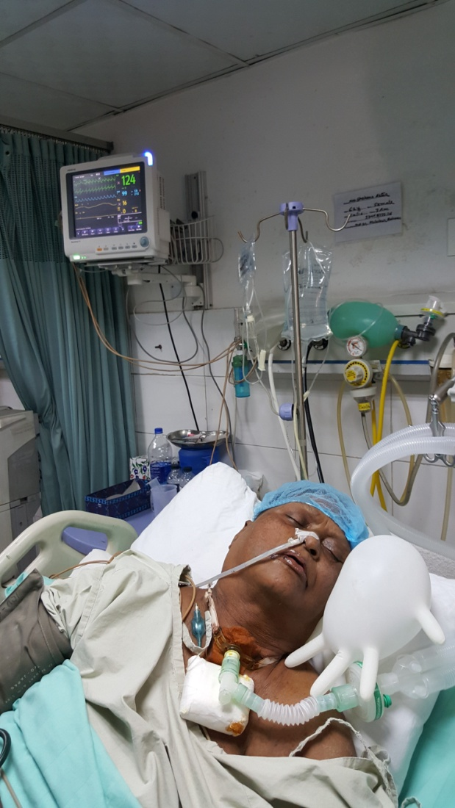
They are this kind of unfortunate patients

Slide 14
Identifying dying patient :
The first aid in dying (AID) statute in the united states, had enacted more than 20 years ago.
Timothy Quill and Colleagues proposed clinical criteria for AID.
Their proposal was carefully considered and temperate, but there was little data on the practice of AID at the time.

Slide 15
Criteria are as follows now a days
Patient likely to require endotracheal intubation and invasive mechanical ventilator support.
Patients requiring support of two or more organ systems (inotropes and haemofiltration).
Patients with chronic impairment of one or more organ system ( eg- COPD or severe Ischaemic heart disease ) who require support for acute reversible failure of another organ.

Slide 16
Where would the patient be best managed ?
ICU
Intensive Care Unit

Slide 17
ICU

Slide 18
END-0F-LIFE CARE
TRANSITION TO HOSPICE
Curative
Prolongation
of
Life
Palliative
Relief
of
Suffering
DIAGNOSIS
DEATH

Slide 20
End-of-life Care
The aim is to present the state of the science concerning issues in end-of-life care which have an impact on intensive care nurses possibilities to provide nursing care for dying patients and their families, which includes:
Patient care
Family care
Resident care

Slide 21
Patient’s Care :
The traditional goals of intensive care are to reduce the morbidity and mortality associated with critical illness, maintain organ function, and restore health. Despite technological advances, death in the intensive care unit (ICU) remain common place.

Slide 22
Patient’s Care cont…
Patients care can be categorize in:
Pharmacological care
Non- pharmacological care

Slide 23
Patient’s Care cont…
Pharmacological care :
Two types of patient get treatment in ICU
Where good outcome is expected
Where only death is expected despite of all supports.

Slide 24
Patient’s Care cont…
Condition where good outcome is expected:
Common conditions that are treated within ICUs where good outcome is expected include:
ARDS
Trauma
Multiple organ failure
Sepsis

Slide 25
Patient’s Care cont…
A. Where good outcome is expected…
These types of patients may need mechanical ventilation support.
May need inotropes support. Needs regular monitoring, and medication according to diagnosis.
B. Groups of patients where only death is expected despite of all supports:
Diagnosed as brain death.

Slide 26
Patient’s Care cont…
Criteria of brain death patient :
Absence of pupillary response to a bright light is documented in both eyes.
Absence of ocular movements.
Absence of corneal reflex.
Absence of facial muscle movement to anxious stimulus.

Slide 27
Patient’s Care cont…
Absence of pharyngeal or tracheal reflex.
Absence of spontaneous respiration.
These types of patients’ relatives are counseled as they may discontinue treatment as there is no chance of survival. (DNAR – Do Not Attempt Resuscitation)

Slide 28
Patient’s Care cont…
Non-pharmacological care :
Primary prevention is preferred. Although there are no data on primary prevention, few things should be maintained
Regular posture change to prevent pressure sore
Daily physiotherapy to prevent DVT
Daily bed bath to maintain cleanliness.
Cleaning after bowel movement.

Slide 29
Daily round in ICU :

Slide 30
Patient / Resident Care
Multiple chronic illnesses
Unpredictable trajectories
Difficulties with assessment
and prognostication
High rate of cognitive impairment

Slide 31
Family care :
Family members of ICU patients may face difficult decisions.
Nurses are in a position to provide support.
Evidence of specific strategies that nurses use to support decision making and how family members respond to these strategies is lacking.

Slide 32
Family care cont…
Family members described five nursing approaches :
Demonstrating concern,
Building rapport,
Demonstrating professionalism,
Providing factual information,
and
Supporting decision-making.

Slide 33
Care for Families
Guilt issues
Unresolved family conflicts
Complex dynamics

Slide 34
Places where counseling done as well as family care given :

Slide 35
Resident care :
Ultimate goal of the recommendation for disinfection and sterilization is to reduce rate of health care associated infection through appropriate use of both disinfection and sterilization.

Slide 36
Resident care cont…
Recommendations are –
Occupational health and exposure- Inform each worker of the possible health effects of his or her exposure to infectious agents,
Ensure that workers wear appropriate PPE to preclude exposure to infectious agents or chemicals through the respiratory system, skin or mucous membrane of eye, nose or mouth. PPE can include gloves, gown, masks and eye protection.

Slide 37
Resident care cont…
Cleaning of patients care devices :
Remove visible organic residue (eg-residue of blood and tissue ).
Use cleaning reagents that are capable of removing visible organic and inorganic residues.

Slide 38
Care of Dying Patient outside the Hospital: Hospice Care

Slide 39
Palliative care and Hospice: Definition of Terms
Palliative Care :
Biopsychosocial and spiritual care of persons whose diseases are not responsive to curative treatment
Goal of Palliative Care :
To produce the best possible quality of life for the patient and family.

Slide 40
Palliative care and Hospice: Definition of Terms
Hospice:
Medicare sponsored program dedicated to provide palliative care for terminally ill patients and their families.
Historians believe the first hospices originated in the 11th century, around 1065.

Slide 41
Palliative care and Hospice: Definition of Terms
Since 2006 the World Hospice and Palliative Care is organized by a committee of the Worldwide Palliative Care Alliance, a network of hospice and palliative care national and regional organizations that support the development of hospice and palliative care worldwide.

Slide 42
Some Challenges of Hospice
Hospice require ‘bad news’ discussion
Acceptance that medical treatment is not working
Acceptance of likelihood of death in 6 months
Giving up on hospitalization and disease driven treatment

Slide 43
Some Challenges of Hospice Cont.
Many patients don’t want to stop all treatment
May be willing to stop burdensome treatment
May want to continue to maintain more options
Small chances of cure or longer life maintain hope.

Slide 44
Hospice care provides:
Improved pain and symptom management
Careful attention to quality of life
Fresh look at medical goal and priorities
Opportunity to consider life closure
Multidisciplinary approach
Focus on patient and family

Slide 45
Hospice care does not require :
Forgo active treatment of underlying disease.
Forgo acute hospitalization
Accept palliation as primary goal of treatment
Accept a 6-month or less prognosis

Slide 46
Some difficult questions:
Should I try experimental therapy ?
Is it time for hospice ?
How can hope be preserved ?
Will I die if suffering becomes unacceptable ?

Slide 47
Should I Try Experimental Therapy :
If it is non-toxic, why not ?
Explore the patient’s values and preferences
Both hope and prepare
Not all miracles are medical
Share your experience and recommendations

Slide 48
Is it time for hospice ?
Hospice is usually a hard transition…
Disease treatment not working
More likely than not to die in next 6 months
More likely forgo aggressive life prolonging therapy

Slide 49
Is it time for hospice ?
Most patient’s and families very satisfied
Intensive multidisplinary focus on quality of life
Care on one’s own home if at all possible
Good back up systems

Slide 50
How Can Hope Be Preserved ?
Medical avenues of hope
Breakthrough from traditional treatment
New or experimental treatment
Enhancing quality of life through palliative treatment

Slide 51
How Can Hope Be Preserved ?
Non-medical dimensions
Spiritual or religious
Family
Alternative therapies
New and different personal goals

Slide 52
Would you help me die, if my suffering becomes unacceptable ?

Slide 53
Will you help me die ?
Full exploration;
Why now ?
Potential meaning of the request
Uncontrolled symptoms
Psychosocial problem
Spiritual crisis
Depression, anxiety
Potential uncontrolled, intolerable suffering

Slide 54
Potential Last Resort Options :
Accelerating opioids to sedation for pain
Stopping life-sustaining therapy
Voluntarily stopping eating and drinking
Palliative sedation potentially to unconsciousness
Physician-assisted death

Slide 55
Euthanasia / Physician Assisted Suicide
Euthanasia also known as assisted suicide or physician / doctor-assisted suicide, and more loosely termed mercy killing, means to take a deliberate action with the express intention of ending a life to relieve intractable (persistent, unstoppable) suffering.

Slide 56
Euthanasia / Physician Assisted Suicide
In the majority of countries euthanasia or assisted suicide is against the law.
According to the National Health Service (NHS), UK, it is illegal to help somebody kill themselves, regardless of circumstances.
Assisted suicide, or voluntary euthanasia carries a maximum sentence of 14 years in prison in the UK, In the USA the law varies in some states.

Slide 57
Euthanasia / Physician Assisted Suicide
There are two main classification of euthanasia:
Voluntary euthanasia- this is the euthanasia conducted with consent. Since 2009 voluntary euthanasia has been legal in Belgium, Luxembourg, Netherlands, Switzerland, and the state of Oregon (USA) and Washington (USA).

Slide 58
Euthanasia / Physician Assisted Suicide
Involuntary euthanasia :
Euthanasia is conducted without consent. The decision is made by another person because the patient is incapable of giving proper informed consent.

Slide 59
PAS in Canada : 2015
Canadian Supreme Court
Fundamental Right to choose physician assisted death.
Potentially includes either PAS or VAE
Criteria included
“Grievous and irremediable medical condition…”
“Causes ending suffering that is intolerable to the individual”
12 month to enact a regulatory framework (June 2016)

Slide 60
Patient/relatives /Surrogate can sign DNI/DNR if he/she/they do not want resuscitation.

Slide 61
Palliative Options of Last Resort : the bottom line…
Only sensible in context of excellent palliative care
Currently, options unevenly/unpredictably available
All options should be subject to similar safeguards
Open processes are ultimately more safe, predictable, and accountable than secret process.

Slide 62
Symptom Prevalence in the Geriatric Dying Patient
Most common symptoms: Fatigue, Pain, Anorexia-Cachexia, Constipation, Dyspnea, Nausea and Vomiting.
Increased prevalence:
Mental confusion
Loss of bladder control
Hearing and visual loss
Dizziness

Slide 63
Symptom Management
Agitation/Delirium
Anxiety/Depression
Anorexia/Cachexia
Constipation
Dyspnea/Shortness of Breath
Control of Secretions
Fatigue
Pain

Slide 64
Symptom Management
Delirium
Occurs in up to 85% of terminally ill pts
Common in last 24-48hours of life
Disturbance in consciousness and cognition: develops in SHORT PERIOD OF TIME
Poor attention, psychomotor agitation or psychomotor retardation, perceptual disturbances, disordered sleep-wake cycle
Related to medical condition

Slide 65
Symptom Management
Hypoxemia
Fecal Impaction
Urinary Retention
Unfamiliar environment
Delirium
Causes:
Medications
Brain Tumor
Metabolic abnormalities
Organ failure
Dehydration
Infection

Slide 66
Symptom Management
Delirium Assessment:
Know your resident
History: important to know onset of change in condition
Medication Review
Physical Exam
Identify Reversible Causes….what can we change…

Slide 67
Symptom Management
Anorexia/Cachexia
Prevalence: 24 to 80% in geriatric population
Definition: Progressive weight loss, lipolysis, loss of organ and skeletal protein and profound loss of appetite.

Slide 68
Symptom Management
Anorexia/Cachexia
Causes
Immune mediators
Tumor products
Change in taste,
Dry mouth, mouth sores
Nausea, constipation
Gastritis, Peptic ulcer disease
Candidiasis of GI tract
Radiation/Chemo TX
Drugs/Medications
Metabolic changes: dehydration
Depression
Pain

Slide 69
Symptom Management
Anorexia/Cachexia
Identify and treat reversible causes:
Reversible causes:
Dry mouth
Oral yeast/Candida infection
Acid Reflux, affecting the esophagus
Nausea/vomiting, constipation
Pain
Depression

Slide 70
Symptom Management
Anorexia/Cachexia
Dietary Changes
Involve resident in menu planning
Offer small portions of resident’s favorite foods
Avoid foods with strong odors
Offer easy-to-swallow food: semi-liquids, puddings, ice cream, soft or pureed foods.

Slide 71
Symptom Management
Anorexia/Cachexia Medication Management:
Appetite Stimulants
Corticosteroids
Progestational drugs
Cannabioids
Thalidomide

Slide 72
Symptom Management
Pain Treatment
Barriers
Fear of addiction
Fear of stigma
Fear of opioids
Related to resident, family, staff, physician
Under report

Slide 73
Symptom Management
Pain Treatment Non-Pharmacologic
“ a hand to hold, a heart to touch…”
Sensory stimulation: Presence
Visual: picture books
Auditory: music
Smell: aromatherapy
Touch: Tactile objects, massage
Taste: sweet

Slide 74
Symptom Management
Pain Treatment Non-Pharmacologic
Exercise programs
Acupuncture
Transcutaneous nerve stimulation (TENS)
Relaxation therapy, guided imagery

Slide 75
Summary
Define palliative care, palliative medicine, palliative therapies
Review how “curative” and “palliative” integrate in patient care.
Review process of creating Goals of Care

Slide 76
Summary
Review symptom management, including pain management, in context of palliative medicine.
Identify the non-cancer terminal diagnoses that can be cared for in a palliative medicine model, including hospice eligibility criteria.

Slide 77
Summary
Palliative medicine: care for the entire patient; body mind and spirit, at any time of life.
Curative and Palliative care are both /and, not either /or…..

Slide 78
Summary
If uncertain whether or not to refer for hospice care, call Medical director of hospice and discuss.
Collaboration, collegiality benefit all, physicians, patients, family, staff WIN:WIN

Slide 79
End of Life Care!

